Slide 1

INTERNAL SMART INDIA HACKATHON 2025
TITLE PAGE
Problem Statement ID – 1604
Problem Statement Title - Conversational Image Recognition Chatbot
Theme-Smart - Automation
PS Category - Software
Team ID-
Team Name- Team Nova

Slide 2
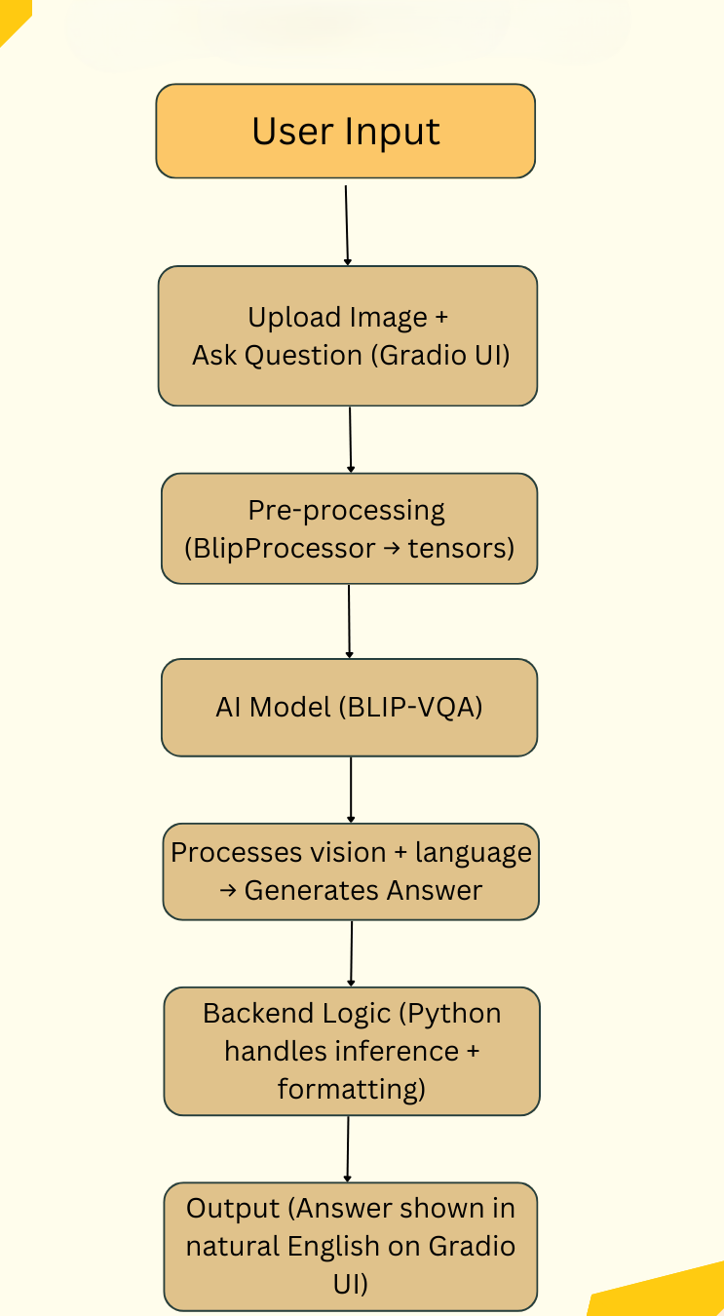
IDEA TITLE
Team Nova
Conversational Image Recognition Chatbot
Interactive Web-based Platform:-.
User-friendly web application where users can upload images.
Users can ask questions in plain English about the uploaded image
2. Real-time Question Answering
The chatbot processes both the image and the user query simultaneously.
Provides instant responses that are accurate and grammatically correct.
3. Core Deep Learning Model
Uses Visual Question Answering (VQA) architecture.
Integrates Computer Vision for object/scene recognition.
Combines with Natural Language Processing (NLP) for query understanding.
4. Seamless User Experience
Simple upload interface and Instant image understanding and conversational replies.
Works across different domains (education, healthcare, defense, retail).
5. Expected Outcomes
Intelligent chatbot that can "see" images and "talk" about them.
High accuracy in recognizing objects and answering related questions.
Improves automation and enhances human–computer interaction.
Idea Flow chart

Slide 3
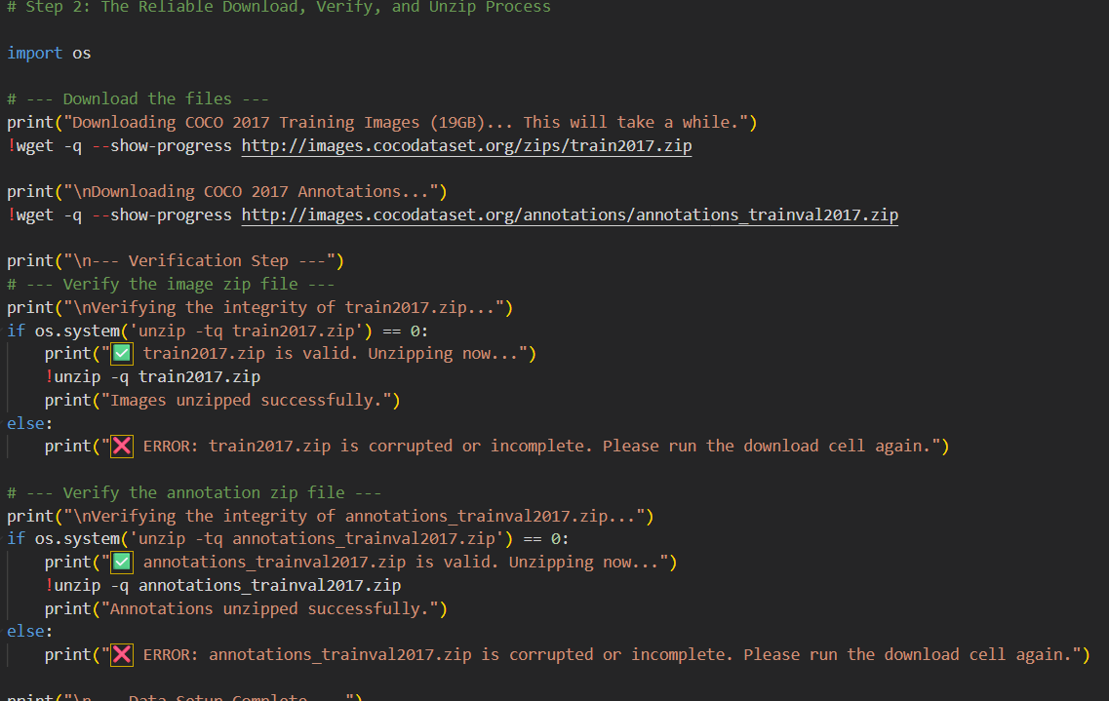
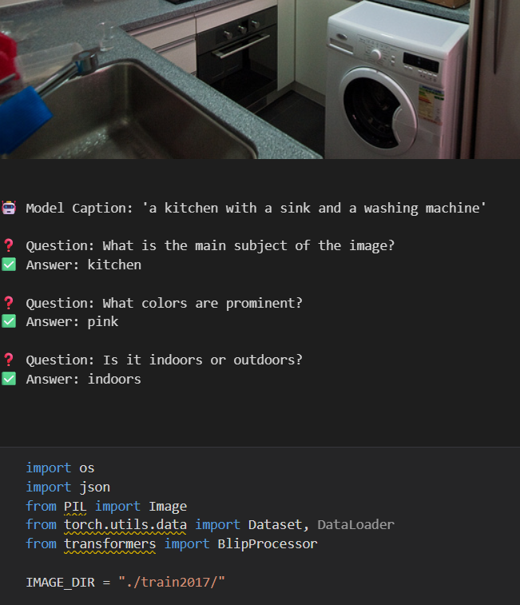
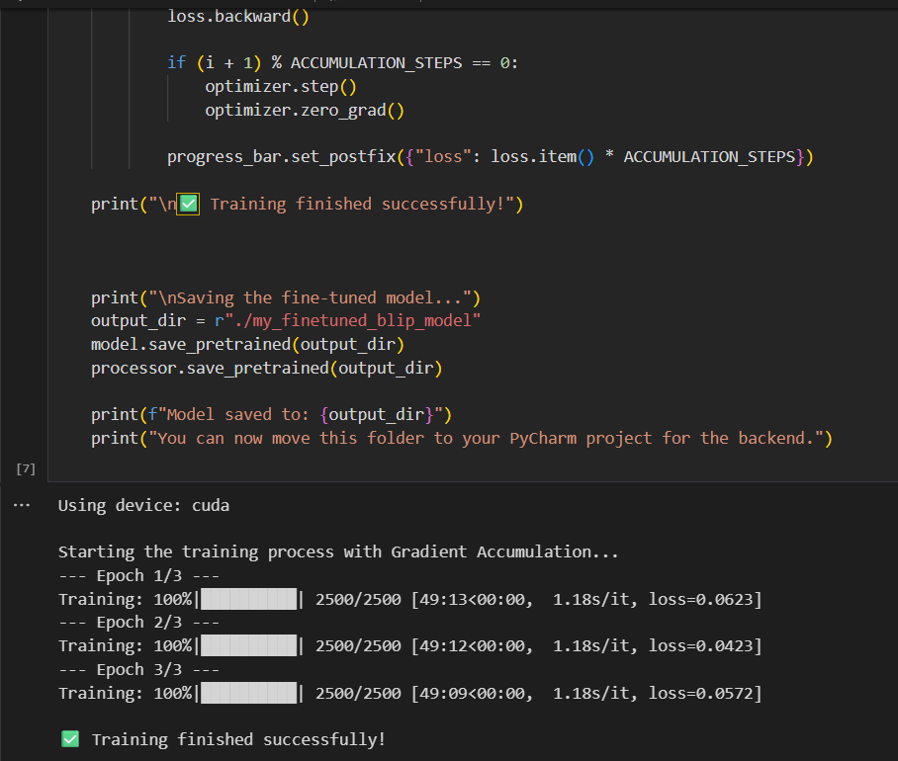
TECHNICAL APPROACH
Team Nova
Technologies Used:-
Language: Python
Frameworks: PyTorch, Hugging Face Transformers
Core Model: BLIP (Salesforce/blip-vqa-base) – Visual Question Answering
Dataset (Future Tuning): COCO 2017
UI Framework: Gradio (interactive web interface)

Slide 4
FEASIBILITY AND VIABILITY
Team Nova
Feasibility Analysis
Technical Feasibility :-
Working prototype already developed.
Core technologies (PyTorch, Transformers, Gradio) are open-source, mature & well-documented.
Resource Feasibility :-
No costly hardware/software required.
Development & training possible on free cloud platforms (Google Colab, Kaggle).
Potential Challenges & Risks :-
Model Hallucination – Wrong/irrelevant answers for abstract or unusual images.
Computational Cost – High resource demand if many users access simultaneously.
Domain Specificity – General model may lack accuracy for niche fields (e.g., medical, satellite).
Strategies to Overcome :-
For Accuracy: Fine-tune model on domain-specific datasets.
For Scalability: Use optimized inference servers (Hugging Face, Docker, cloud deployment).
For Cost: Apply model optimization (Quantization, ONNX) → faster inference & reduced costs.

Slide 5
IMPACT AND BENEFITS
Team Nova
Impact and Benefits
Potential Impact on Target Audience:-
Visually Impaired Users: Assistive tool that describes the visual world and answers image-based queries.
E-commerce: Enables visual product search (e.g., “Is this available in blue?”).
Education: Interactive learning with historical images, scientific diagrams, and artworks.
Social Media: Automates content moderation by analyzing images for violations.
Benefits of the Solution:-
Social Benefit: Enhances digital accessibility for visually impaired communities.
Economic Benefit: Reduces customer support costs & increases user engagement in online retail.
Educational Benefit: Provides an engaging, interactive way of learning with visuals

Slide 6
RESEARCH AND REFERENCES
Team Nova
Core Model Paper
Li, J., Li, D., Xiong, C., & Hoi, S. (2022).
BLIP: Bootstrapping Language-Image Pre-training for Unified Vision-Language Understanding and Generation.
arXiv:2201.12086 Core Technology Documentation:-
Hugging Face Transformers → https://huggingface.co/docs/transformers
Gradio UI Library → https://www.gradio.app/
PyTorch → https://pytorch.org/
Dataset:-
-COCO – Common Objects in Context → https://cocodataset.org/

